Slide 1
Unit 3B
Human Form & Function
Cells, metabolism & regulation
Specific resistance

Slide 2

Study Guide
Read:
Our Human Species (3rd edtn)
Chapter 14, sections 10-13
Complete:
Human Biological Science Workbook
Topic 9 – Specific Resistance

Slide 3
Specific immunity
Specific immunity protects the body against specific substances (antigens).
There are two types of specific immunity, cellular immunity and antibody mediated (humoral) immunity.
Specific immunity is acquired through natural infection or immunisation.

Slide 4
Lymphatic system
The lymphatic system comprises lymph, lymph nodes, lymph vessels, the spleen, tonsils and thymus.
The lymphatic system plays a vital role in protecting the body from pathogens and cancer cells, and removing debris (e.g. old blood cells) from the circulation.

Slide 5
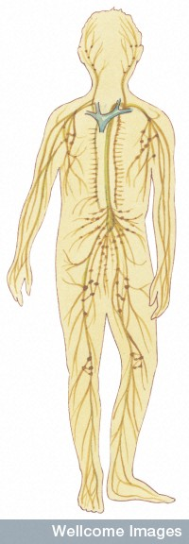
The lymphatic system
Lymphatic duct
Lymph nodes
Lymph vessels

Slide 6
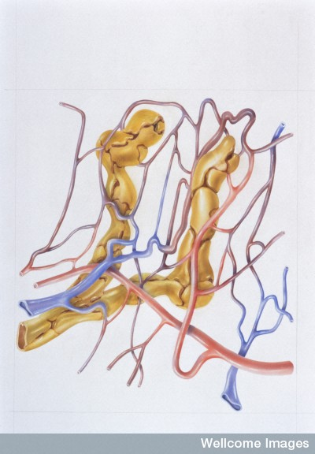
A lymph capillary
Capillary
Lymph capillary
Arteriole
Venule
Medical Art Services, Munich, Wellcome Images

Slide 7
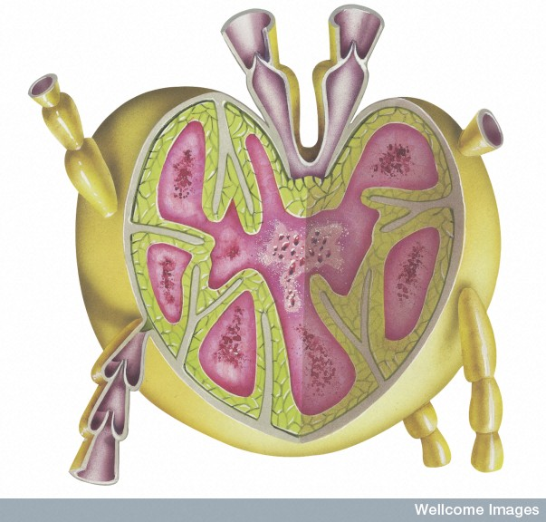
Section through a lymph node
Efferent lymph vessels
Cortex
(T lymphocytes)
Medulla
(macrophages)
Germinal centre
(B lymphocytes)
Afferent lymph vessels
The Miles Kelly Art library, Wellcome Images

Slide 8
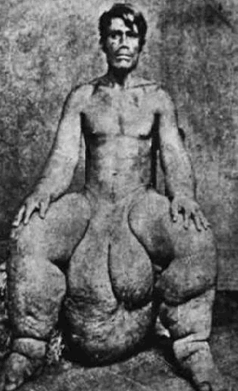
Elephantiasis
Elephantiasis is a disease, often found in tropical countries, in which a small roundworm blocks the lymphatic vessels, usually in the legs or scrotum.

Slide 9
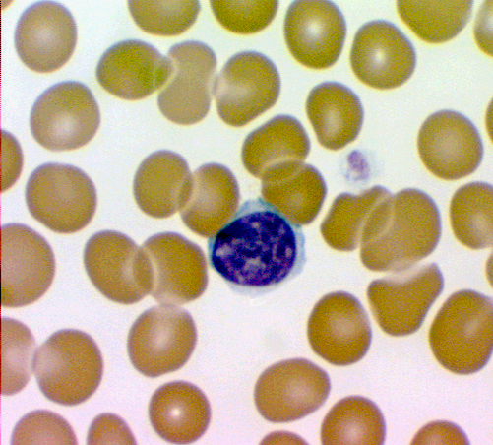
Lymphocyte
Lymphocytes are specialised white blood cells, which play a crucial role in the body's specific immune system
Lymphocytes have a spherical nucleus surrounded by a thin layer of non-granular cytoplasm.

Slide 10
B lymphocytes and T lymphocytes
There are two types of lymphocytes; B lymphocytes (B cells) and T lymphocytes (T cells).
Both types are produced in bone marrow.
B lymphocytes are ‘educated’ (acquire immunological competence) in bone marrow.
T lymphocytes are ‘educated’ in the thymus.

Slide 11
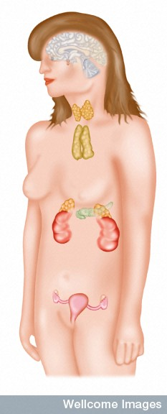
Thymus
The thymus is a mass of glandular tissue located in the upper chest under the breastbone.
The thymus is most active during puberty, but atrophies (gets smaller) in adults.
Thymus
Wellcome Photo Library

Slide 12
B cells | T cells
Humoral immunity Antibody mediated immunity | Cellular immunity Cell mediated immunity
Chemical-based system | Cell-based system
Produce antibody (Ig) | Produce killer cells
Lymphocytes educated in bone marrow | Lymphocytes educated in thymus
Effective against extracellular bacteria ( some viruses) | Effective against intracellular viruses & cancer cells (some bacteria)

Slide 13
Antigens and antibodies
An antigen is a substance (such as a protein or peptide) that is recognised by the immune system and which initiates an immune response.
Antibodies are globular proteins that are secreted by B lymphocytes and interact with specific antigens.

Slide 14
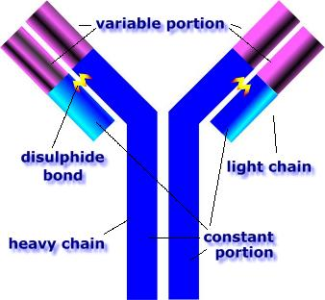
Antibody
The variable portion, which is different in each antibody, allows an antibody to recognise its matching antigen.

Slide 15
Antibody
Antibodies are complex proteins referred to as immunoglobulins (Ig).
There are several types of antibodies, each having a specific function.
Typically, antibodies immobilise foreign cells with which they come into contact by making them stick together (agglutination).

Slide 16
Major histocompatibility complex (MHC)
Major histocompatibility complex (MHC) is a group of genes that are unique in every individual.
They code for small protein molecules that act as ‘self’ markers on all body cells.
MHC molecules initiate the immune response by presenting antigen fragments to T cells.

Slide 17
Antibody mediated immunity
Antigens on foreign cells, such as bacteria, are recognised by receptors on specific B cells.
The antigen is digested by the B cell and antigen fragments are displayed on the cell surface.
T helper cells with matching receptors become activated when they lock onto the antigen fragment.

Slide 18
The activated T cells secrete cytokines, (messenger proteins that regulate the immune system).
Cytokines stimulate the B cell to divide, producing numerous plasma cells.
The plasma cells secrete antibodies into the circulation.

Slide 19
Antibody mediated immunity
1. Pathogen displaying antigens
2. Antigen recognised by compatible antibody
3. B cell digests antigen & displays antigen fragments
T helper cell
4. T helper cell recognises antigen
6. Cytokines cause B cell to mature into plasma cell
B cell
5. Activated T helper cell releases cytokines
7. Plasma cell secretes antibody

Slide 20
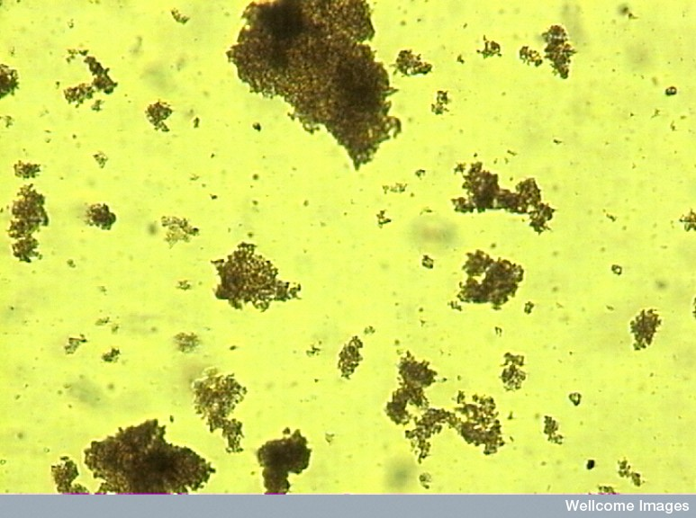
Agglutination
When antibodies come into contact with target antigens they lock onto them. This causes the antigen-bearing cells (often pathogens) to bind together (agglutinate), thus rendering them harmless.
Agglutinated meningococcal cells
Mike Sobanski, Wellcome Images

Slide 21
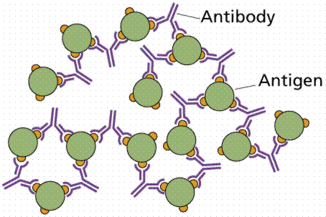
Agglutination

Slide 22
Cellular immunity
A ‘sick’ cell is ingested by an antigen presenting cell (macrophage or dendritic cell).
Antigen fragments bound to MHC molecules are displayed on surface of APC.
Compatible T cells lock onto antigen-MHC complex and secrete cytokines.

Slide 23
Cytokines stimulate T cells to divide and differentiate into killer cells, helper cells and memory cells.
Killer cells (cytotoxic T cells) destroy body cells infected by viruses or transformed by cancer.
Helper T cells perform many immune functions. They are essential for activating cytotoxic T cells, and B cells.
Memory cells remain in the body and enable the immune system to react rapidly should it encounter those same antigens again.

Slide 24
Antigen presenting cells
1.
Pathogen ingested by antigen presenting cell
3.
Antigen presented on MHC complex
Antigen presenting cell
2.
Pathogen digested by APC
4.
T cell with complimentary antigen receptor site
T cell

Slide 25
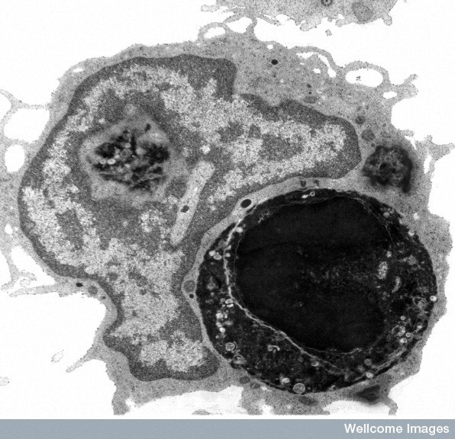
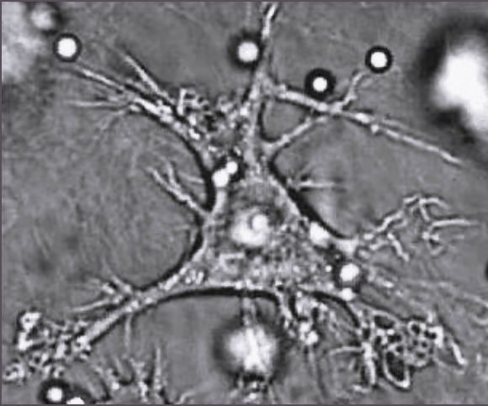
Antigen presenting cells
Micrograph of a macrophage ingesting another cell (dark) by phagocytosis.
Micrograph of a dendritic cell.
Judith Behnsen, Priyanka Narang, Mike Hasenberg, Frank Gunzer, Ursula Bilitewski, Nina Klippel, Manfred Rohde, Matthias Brock, Axel A. Brakhage, Matthias Gunzer
Jerremy Skapper, Wellcome Images

Slide 26
Cellular immunity
1. Pathogen ingested by macrophage or dendritic cell
Memory
T cell
5. Killer T cells hunt and destroy infected cells
4. Cytokines stimulate killer T cells to divide
Killer
T cell
Killer
T cell
Helper
T cell
3. Helper T cells secrete cytokines
Helper
T cell
2. Pathogen digested & fragments presented to T cells
B cell
Cytokines activate B pathway

Slide 27
Primary and secondary responses
Secondary response
Primary response
Antibody conc in serum
Time (weeks)
The primary response takes about two weeks to peak and antibody levels do not remain high. During the secondary response, antibody levels rise faster, reach higher concentrations and remain elevated for an extended period.

Slide 28
Active & passive immunity
Active immunity (antigen activated) immune system activated memory cells produced (= immunity acquired) protection slow to develop but permanent | Natural – involves B & T cells Artificial – vaccines (dead or attenuated)
Passive immunity (antibody activated) immune system NOT activated NO memory cells formed (= NO immunity acquired) protection immediate but only temporary | Natural – IgG cross placenta IgA in breast milk Artificial -serum

Slide 29
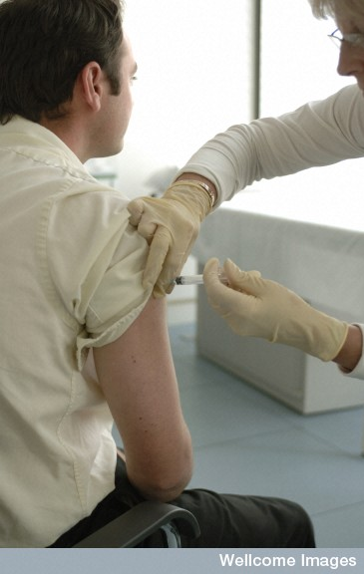
Artificial immunity
A vaccine is a preparation made of weakened or dead pathogenic cells injected into the body in order to stimulate the production of antibodies.
Vaccinations mimic the body’s natural immune response.
Wellcome Library

Slide 30
Dead vaccines | Attenuated vaccines
Contain killed microorganisms (using chemicals or heat). Examples include vaccines against flu, cholera and hepatitis A. | Use live micro-organisms that have been disabled, or closely-related organisms that are less dangerous. Attenuated vaccines generally produce a more durable immunological response but are less stable than dead vaccines. Examples include vaccines against measles, rubella and mumps.

Slide 31
Active immunity
 | Exposure | Dosage | Effects | Immune response
Natural | Active pathogen | Very small amount | Person gets ill | Acquires active immunity
Artificial | Dead or altered pathogen = vaccine | Very large amount | Person does not get ill | Acquires active immunity

Slide 32
Passive immunity
 | Exposure | Effects | Immune response
Natural | Antibody enters fetus via placenta or breast milk | Baby does not get ill - obtains immediate, short-term protection | Baby does not acquire immunity – will get ill on subsequent exposure
Artificial | Serum | Person does not get ill - obtains immediate, short-term protection | Person does not acquire immunity – will get ill on subsequent exposure

